Slide 1

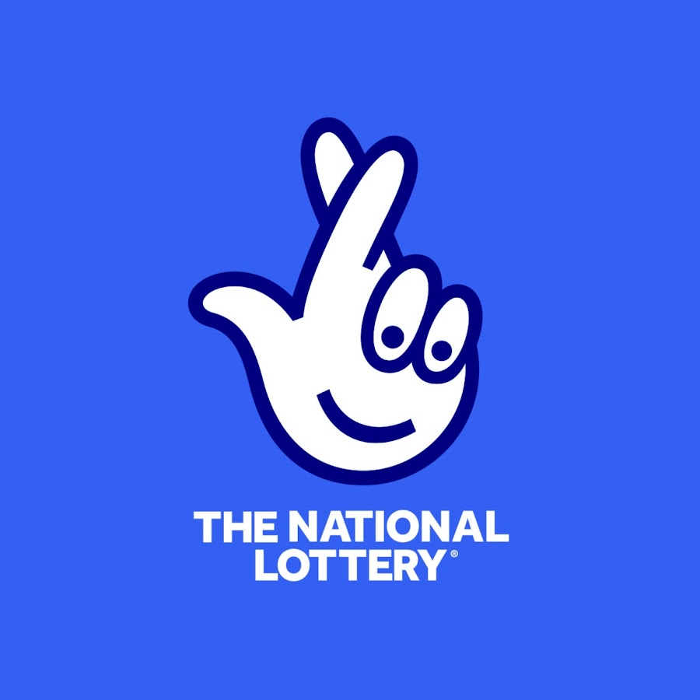

Analysis of National lottery sales performance
Insights into sales and jackpot dynamics

Slide 2
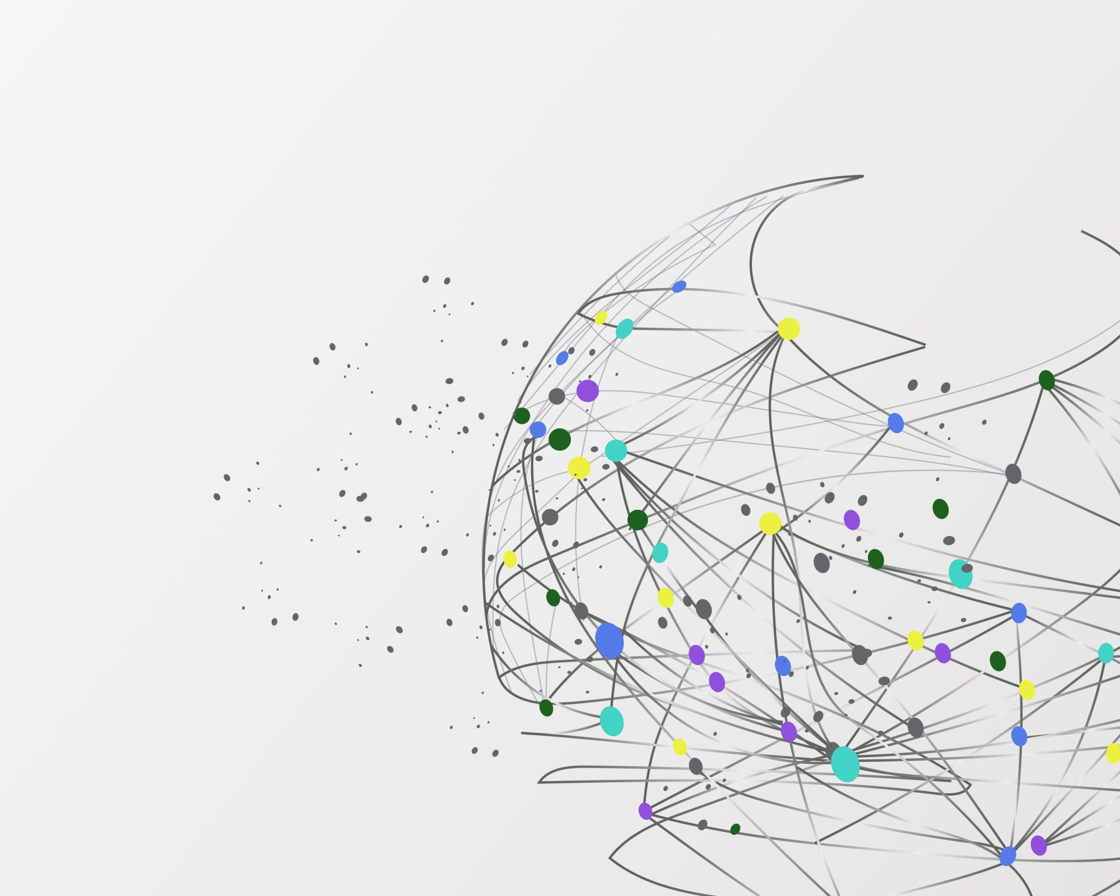
agenda
Introduction to the National Lottery
Sales performance Analysis
Relationship between Sales and Jackpots
Trends over the last three Financial years Performance
Impact of External Factors on sales
Conclusions and recommendations

Slide 3

introduction
National lottery significance and analysis objectives

Slide 4
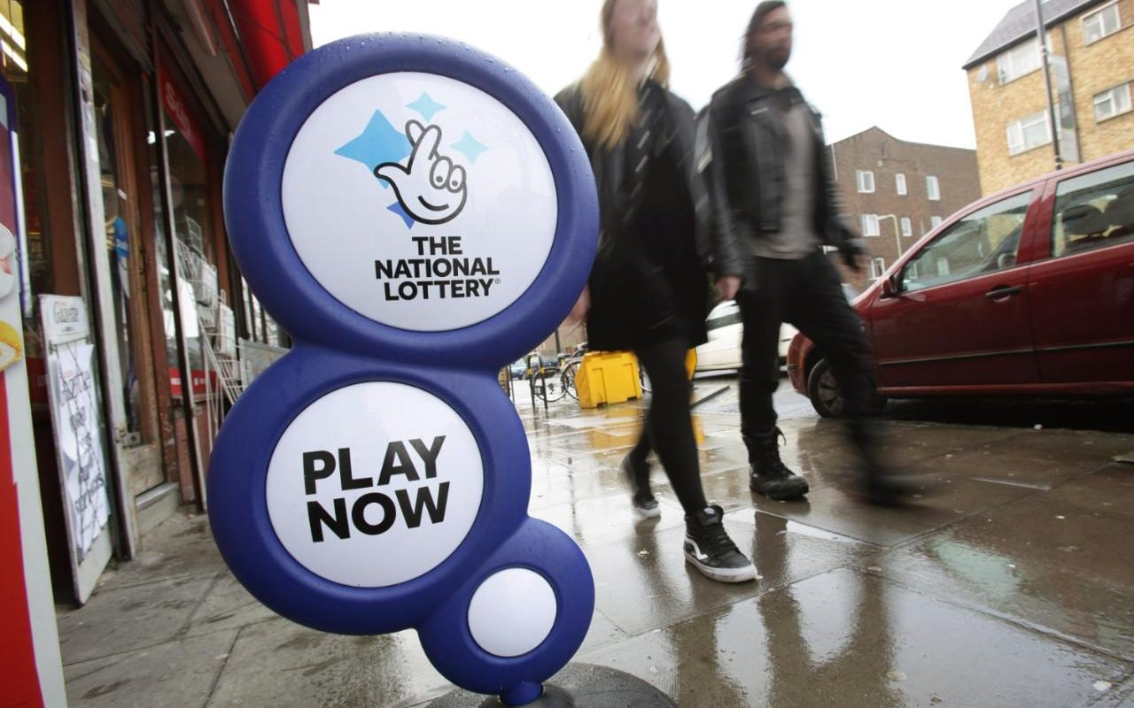
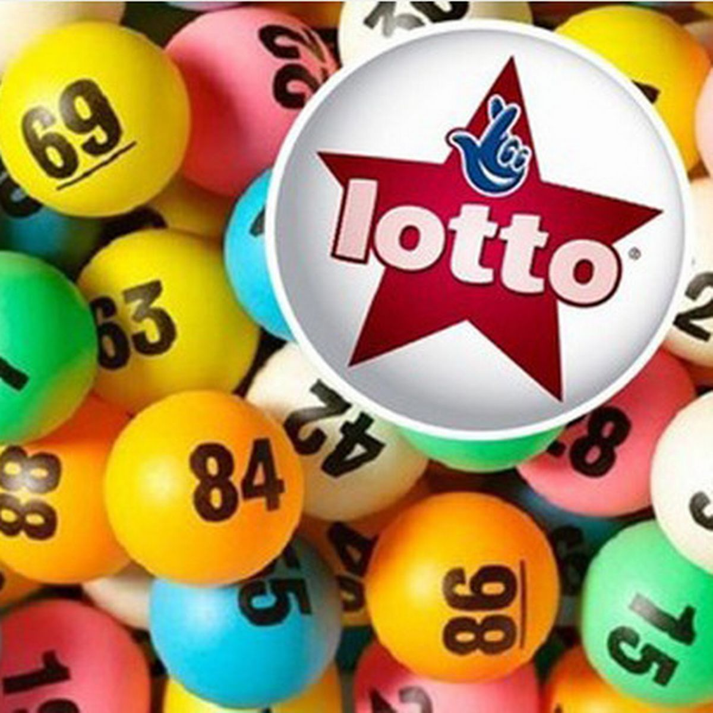
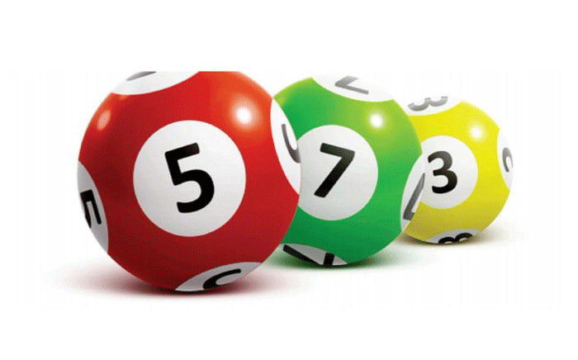

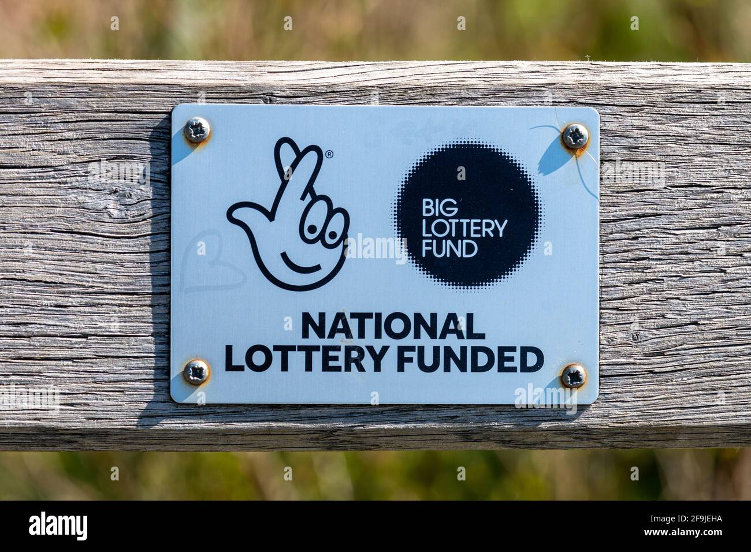
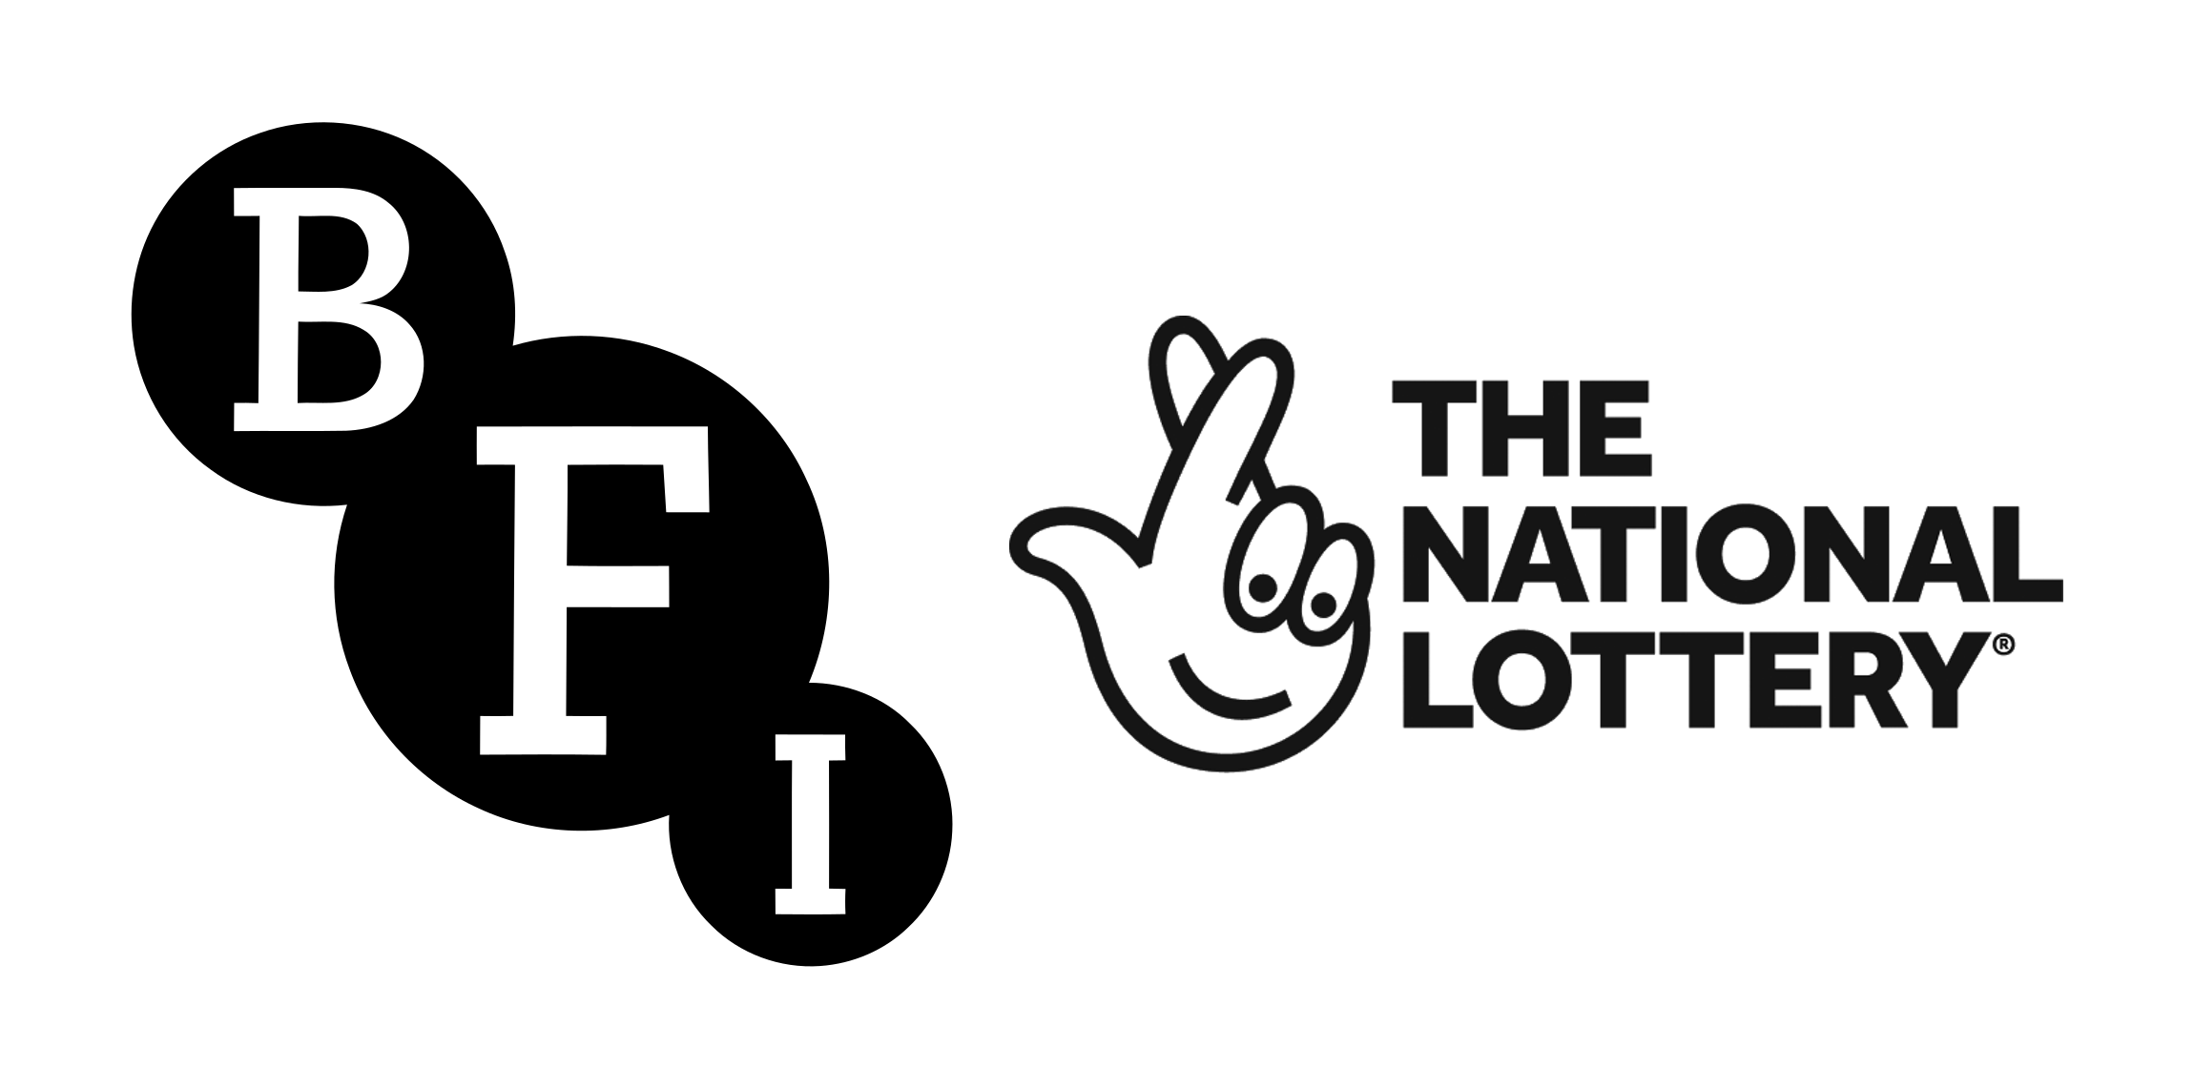

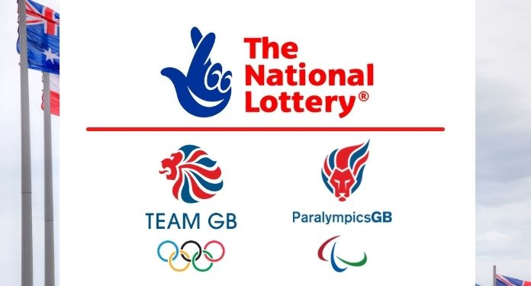
Significance of national lottery
Recreational activity in the UK, offering a range of games.
Vital contributor to good causes,
Influencing cultural projects, community development, and individual fortunes

Slide 5
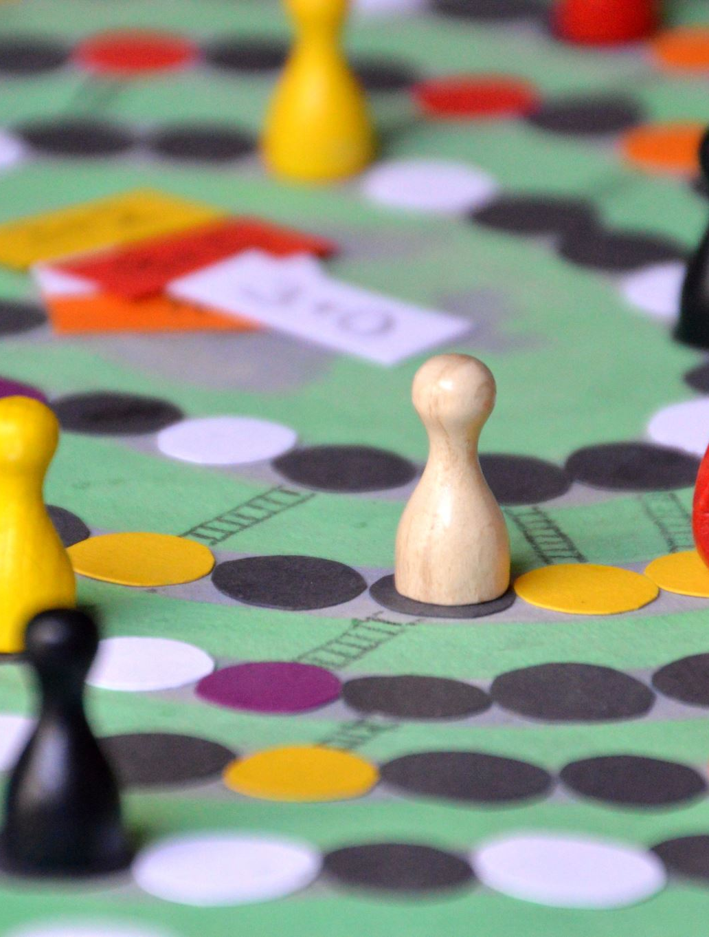
Understanding lottery dynamics
Analysis to provide actionable insights into the sales performance of National Lottery games
Patterns to inform future strategies for game promotion

Slide 6
sales analysis –game 1

Slide 9
Sales analysis –game 2

Slide 12
Sales analysis –game 3

Slide 14
Sales analysis –game 4

Slide 16
Sales analysis of all games

Slide 19
Trends over the last three financial years

Slide 20
Game 1 Performance:
Steady growth with a 4.31% increase in sales.
Demonstrated consistent player interest and market presence.
Game 2 Performance:
Notable growth at 11.48%, indicating increased market capture.
Suggests successful strategies in customer engagement and retention.
Game 3 Performance:
A decline of 5.14%, signaling a need for market reassessment.
Potential factors could include increased competition or market saturation.
Game 4 Performance:
Remarkable growth at 138.88%, showing a significant rise in popularity.
Strategic implications for market expansion and investment
Game 4 outperformed all during Covid pandemic with evident growth.

Slide 21
Impacts of external factors

Slide 22
COVID-19 Pandemic and Sales Trends
Shift to Digital Platforms
Economic Factors
Innovation in Lottery Games

Slide 23
conclusions

Slide 24
Overall sales increased from from £6.60 billion to £7.40 billion
Game 3 has the highest share among sales and Game 4 has the lowest .
Game 3 sales are in decline and Game 4 has the highest growth rate.
Jackpot amount and sales have a positive correlation.

Slide 25
recommendations

Slide 26
Enhance Digital Presence
Economic Sensitivity
Game Innovation
Leverage Seasonal and Monthly Trends
Pandemic Response and Flexibility

Slide 27
THANK YOU

